Slide 1
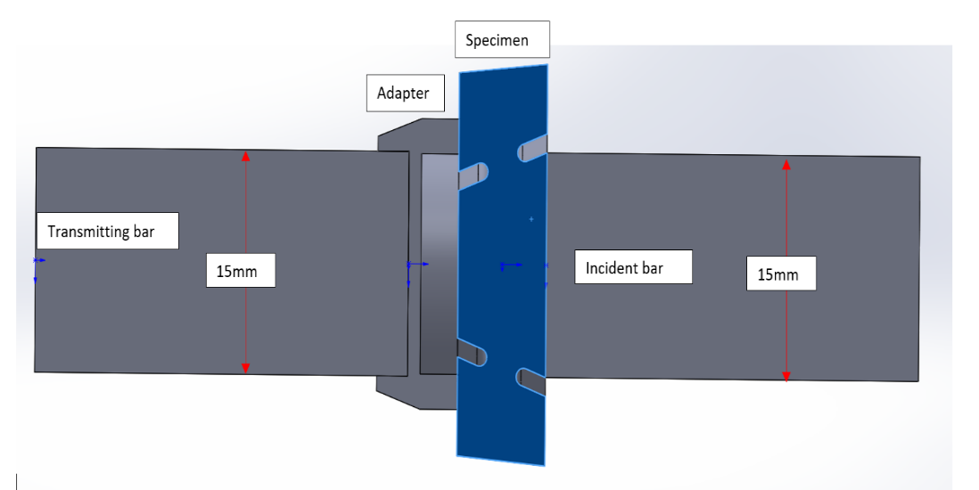
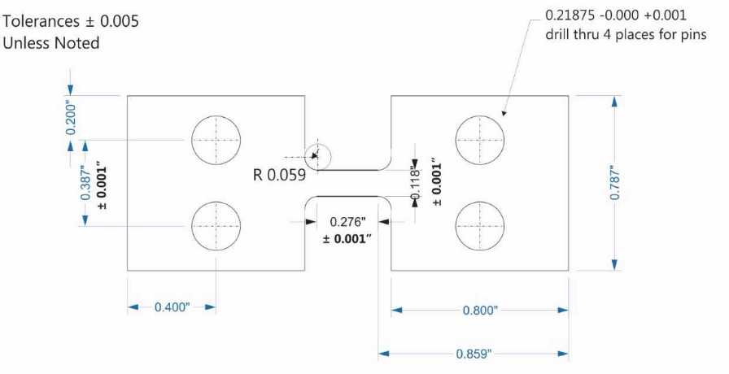
INCO 590 Final Report
A study of stress triaxiality levels on axisymmetric specimens to determine fracture properties of ductile materials
The manufacturing of tension Inconel specimens to understand the materials fracture mechanics under specific strain rates

Slide 2
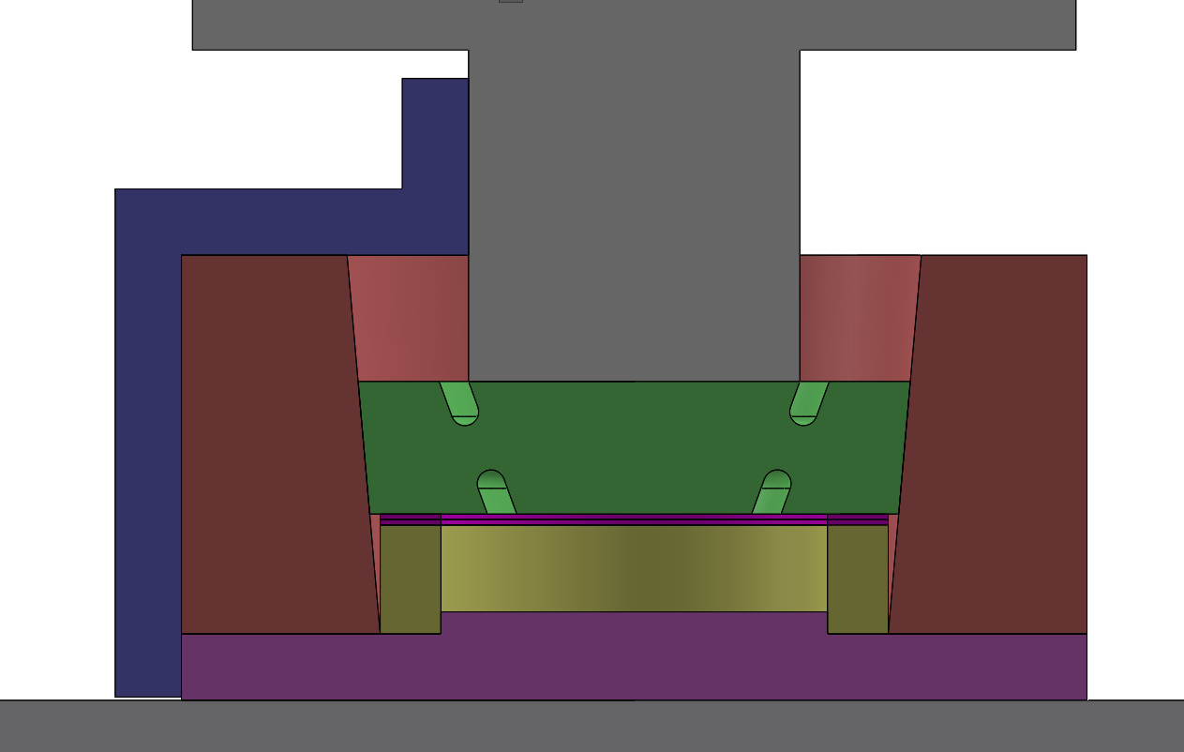
Abstract
The importance of this research is to further our knowledge on how materials behave in different strain rate applications and how that relates to the stress triaxiality of the material. The Inconel tests are to understand how Inconel behaves given the type of rolling direction being used in the gage section. The tests will be performed at UNH and NIST given the required strain rate. The testing and analysis of the material will be performed during the Summer of 2018.
The design of the shear compression disk was carefully selected to ensure quality data collection at UNH and NIST, either in the quasi-static or dynamic tests. Various other parts needed to be designed to ensure correct alignment in the various configurations. The manufacturing of the Inconel 625 specimens must be within a tight tolerance in order to remain consistent on all the tests that will be performed.

Slide 3
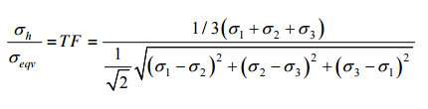
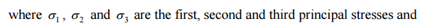
The Study of Triaxiality ​in a Dynamic Assembly
The dynamic assembly includes the transmitting and incident bars, an adapter and the shear compression disk (specimen). The incident bar is hit at different strain rates to study the stress triaxiality in the specimen. The adapter is used to allow the specimen to deform in the gage section until final fracture of the specimen
Stress Triaxiality: is the ratio of hydrostatic stress to the equivalent (von Mises) stress
η =

Slide 4
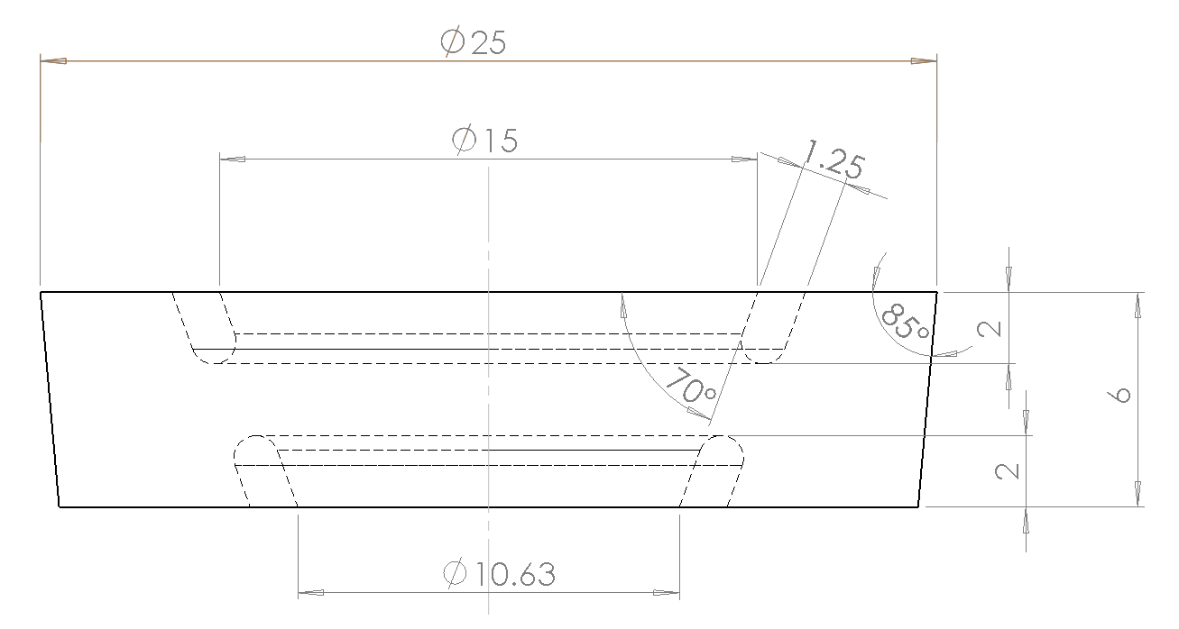
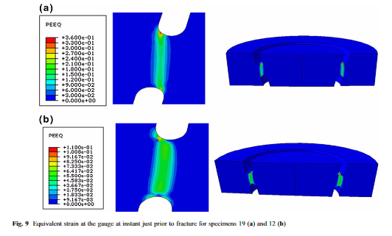
Design of the Shear Compression Disk
The specimen was designed to fracture given the constraints of the Kolsky bars at the National Institute of Standards Technology (NIST). The gage section had to be analyzed using FEA to ensure a factor of safety below one to get fracture given the force the kolsky bar can provide at NIST.
Fracture is preferred to occur at the middle of the gage section to get clear results on the actual behavior of the material without the bias of beginning fracture on the edge. The figure to the right, which was created by Rittel et all, shows the fracture beginning on the edge of the gage section

Slide 5
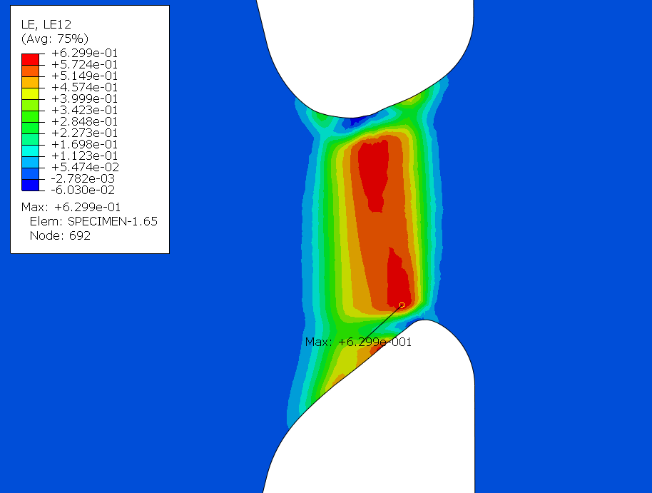
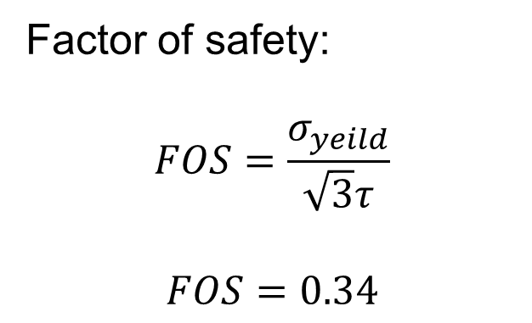
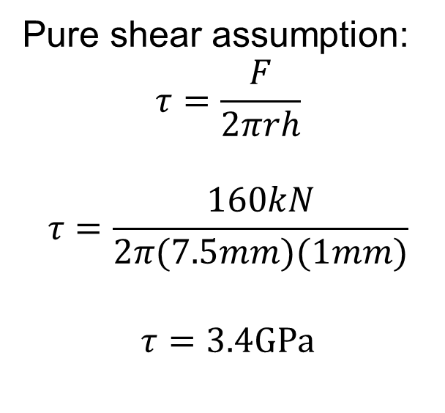
Hand Calculated FOS and ABAQUS Simulations
Pure shear assumption:
$$τ=\frac{F}{2πrh}$$
$$τ=\frac{160kN}{2π(7.5mm)(1mm)}$$
$$τ=3.4GPa$$
Factor of safety:
$$FOS=\frac{σ_{yeild}}{\sqrt{3}τ}$$
$$FOS=0.34$$
The final gage design incorporates the integration of minimum area occurring in the middle of the gage section. The simulation ensured a fracture in the desired location.

Slide 6
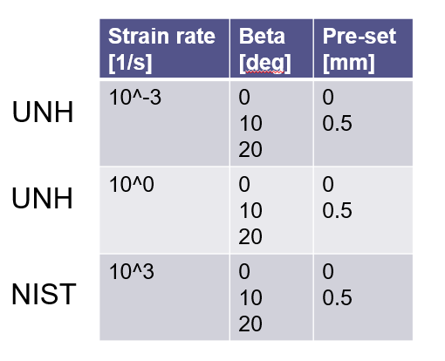
Experiment Design and Future Analysis at NIST
The shear compression disks will be designed in different configurations. There will be a total of 6 different configurations tested at 3 different strains rates. Two of them can be tested at UNH while the high strain rate must be tested at NIST on the kolsky bar. The stress triaxiality will be measured and analyzed to understand how the material behaves given the different configuration and strain rates. The testing, manufacturing and analysis will be completed during the Summer of 2018 at NIST.

Slide 7
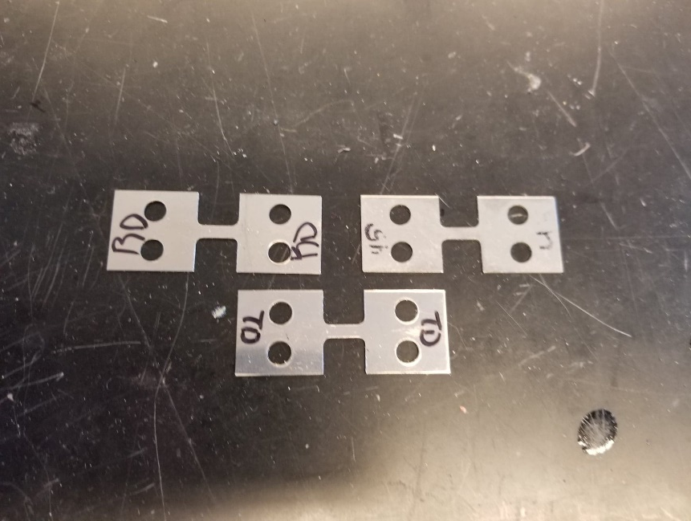
The Manufacturing of Inconel Specimens for Tension Tests
To maximize the time on the state of the art equipment at NIST, we will be testing the fracture mechanics of Inconel 625 in Tension along the gage section.
At NIST, we will be testing three different specimens using Inconel 625. The difference between the three is the direction of rolling. We have manufactured 10 specimens each in the rolling direction, transverse direction and the 45 degree direction.

Slide 8
References
Rittel et all. “A Shear Compression Disk Specimen with Controlled Stress
Triaxiality under Quasi-Static Loading” Israel Institute of Technology, pp. 1 to 14 (2011).
Rittel et all. "A Shear Compression Disk Specimen with Controlled Stress
Triaxiality Under Dynamic Loading” Israel Institute of Technology, pp. 1 to 14 (2012).

